Slide 1
Data Science Major Project
Transport Demand Prediction

Slide 2
Objective:
.
The goal of this project is to predict how many seats will be sold per ride based on historical booking data.
Accurate demand prediction helps:
Allocate the right number of vehicles.
Avoid under-utilization or overbooking.
Improve customer satisfaction and increase revenue.

Slide 3
Dataset:
Size: 51,645 rows × 10 columns
Key Columns:
ride_id, travel_date, travel_time, travel_from, travel_to, car_type, max_capacity,
seat_number
Cleaning Steps:
Removed duplicates
Standardized car_type
Converted travel_date to datetime format
Aggregated seats sold per ride
Added a feature for peak demand (rides above 75th percentile)

Slide 4
Feature Engineering:
We generated several new features to improve prediction accuracy:
Date-based features:
  day_of_week (Monday, Tuesday, …)
  month (1-12)
Time-based features:
  hour (numeric hour extracted from travel_time)
Categorical Encoding:
Applied one-hot encoding to travel_from, car_type, and day_of_week to convert categorical values into numeric form.
Dropped columns:
Removed ride_id, travel_date, travel_time, and travel_to (not directly useful for prediction).

Slide 5
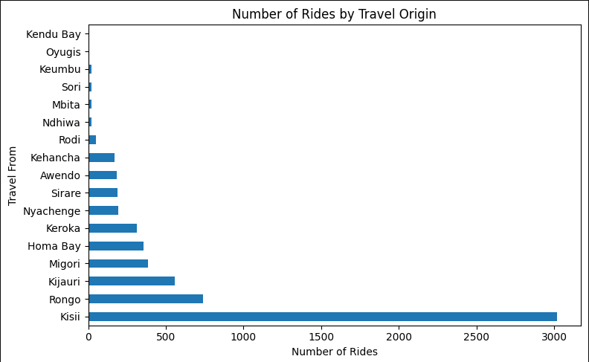
Data Visualization:
Key Observations:
Kisii has the highest number of rides, significantly more than any other location (almost 3000 rides).
Rongo and Kijauri follow, but their numbers are much lower than Kisii’s.
Other moderately contributing locations include Migori, Homa Bay, and Keroka.
Locations like Keumbu, Sori, Mbita, Ndhiwa, and Oygis have very few rides.

Slide 6
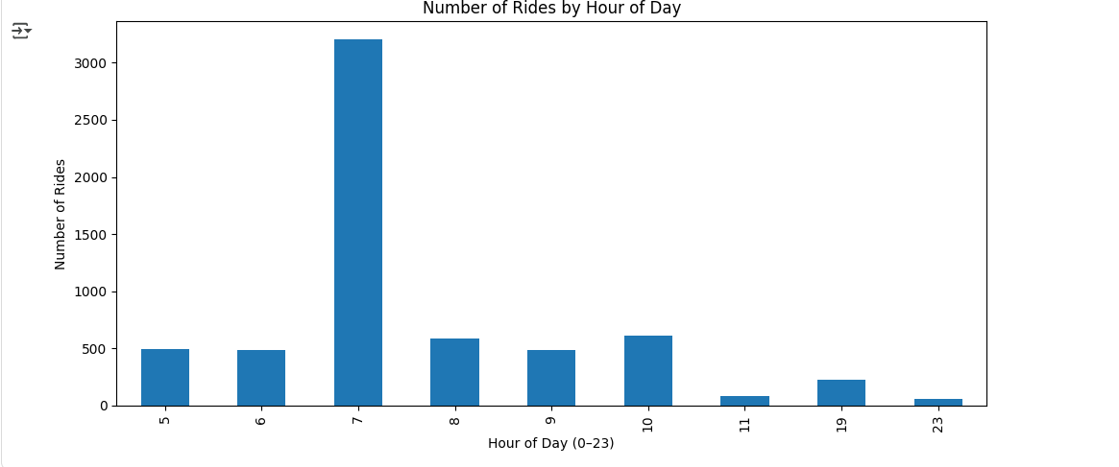
Key Observations
Peak Hour is 7 AM –
The bar for 7:00 is much higher than all other hours, meaning a majority of rides are concentrated early in the morning.
This indicates commuting or school/work rush hour demand.
Moderate Demand in 5 AM, 6 AM, 8 AM, 10 AM –
There are smaller peaks around 5–6 AM and 8–10 AM, showing early-morning and late-morning trips.
Very Low Demand in Evening & Late Night –
19:00 (7 PM) has a small number of rides, and 23:00 (11 PM) & 11:00 have the lowest.

Slide 7
Model Used:Random Forest Regressor
Why Random Forest is the Best Model for Seat Demand Prediction
1. Handles Non-Linearity
Seat demand is influenced by multiple factors (route, hour, day, month, car type).
These relationships are not purely linear — for example:
  Demand might spike during specific hours (7 AM) or days (weekends).
  Some routes might always have high demand, regardless of other variables.
Random Forest captures these nonlinear relationships much better than simple models like Linear Regression.
2. Works Well with Mixed Data
Your dataset contains numeric features (hour, month, max_capacity) and categorical features (travel_from, car_type).
Random Forest can handle both types of data naturally, without heavy assumptions about distributions.

Slide 8
3. Robust to Outliers & Missing Values
RF uses decision trees, which split data into groups and are less affected by extreme values.
This is helpful because real-world booking data can have anomalies (e.g., one-off events, special days with very high demand).
4. Feature Importance Insights
RF gives you a feature importance ranking, which tells you which factors
Influence demand the most.
Example from your project:
  travel_from (boarding location)
  hour (time of day)
  month (seasonal demand patterns)
These insights are very useful for the business team to plan resource allocation.

Slide 9
Key Results:
Model | MAE | RMSE | R²
Random Forest | 3.3125 | 20.9472 | 0.7396
Insight: Evening Demand is Lower
Observation
When we analyzed the rides by hour, we found:
  Peak demand around 7 AM (commuters traveling to work, school, etc.)
  Moderate demand during the day
  Lower demand in the evening — especially after office hours.

Slide 10
Possible Reason
Traffic Congestion: Evening traffic in many cities is very heavy, discouraging passengers from booking rides.
Commuter Behavior: Many passengers prefer earlier trips to avoid getting stuck in traffic.
Business Recommendation
Allocate fewer vehicles during evening hours to avoid underutilization.
Use this insight to adjust schedule dynamically — increase vehicles in morning peak hours and reduce them in low-demand evening hours.

